Slide 1
Accessing And Manipulating Collections In Mongo Db
Name: B . Charith Reddy
Roll No: 22H51A0503
Section : CSE-D

Slide 2
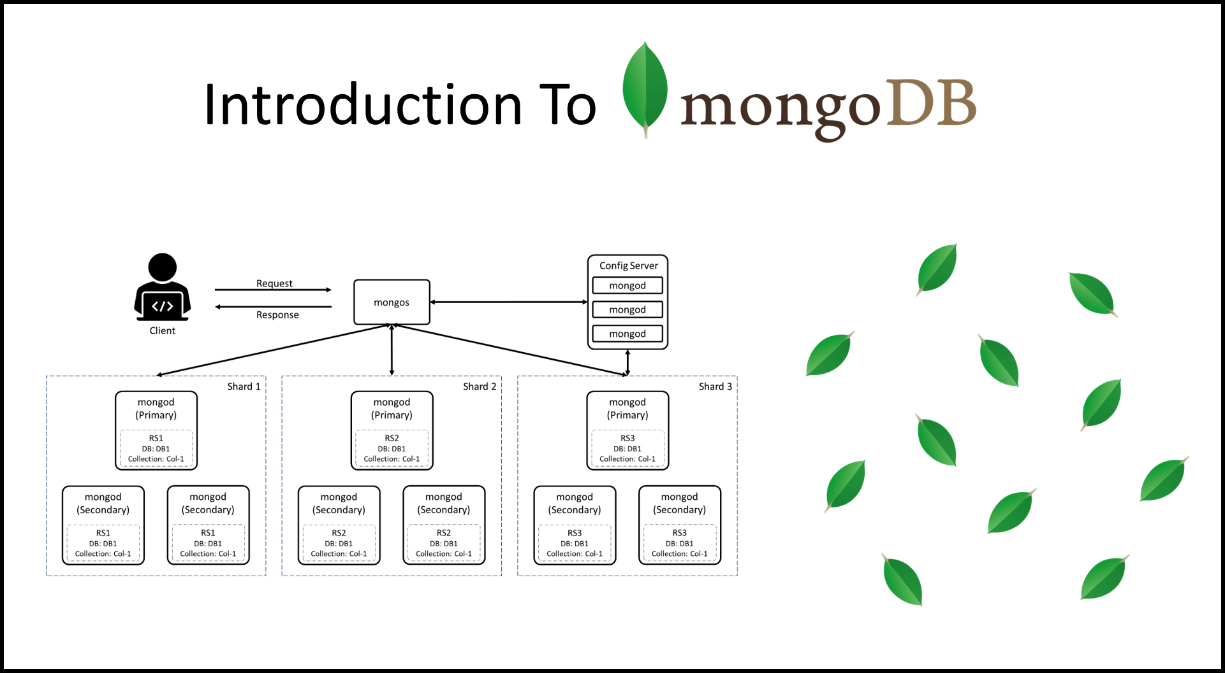
Introduction to MongoDB
MongoDB is a NoSQL database designed for flexibility and scalability.
It stores data in a format called BSON, which is similar to JSON.
Collections in MongoDB are analogous to tables in relational databases.
Notes:
Image source: https://digitalvarys.com/introduction-to-mongodb/

Slide 3
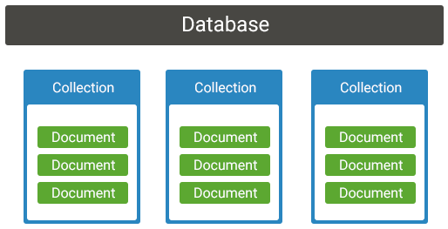
Understanding Collections
A collection is a grouping of MongoDB documents.
Collections do not enforce a schema, allowing for diverse documents.
Each document within a collection can have different fields.
Notes:
Image source: https://www.koderhq.com/tutorial/mongodb/collection/

Slide 4
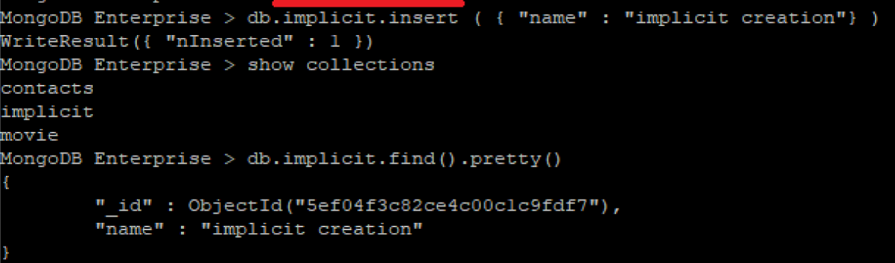
Creating a Collection
Collections can be created automatically by inserting a document.
Use the `db.createCollection()` method for explicit creation.
The command can also define validation rules and options.
Notes:
Image source: https://morioh.com/a/55dc7c02e6c7/how-to-use-the-createcollection-method-in-mongodb

Slide 5
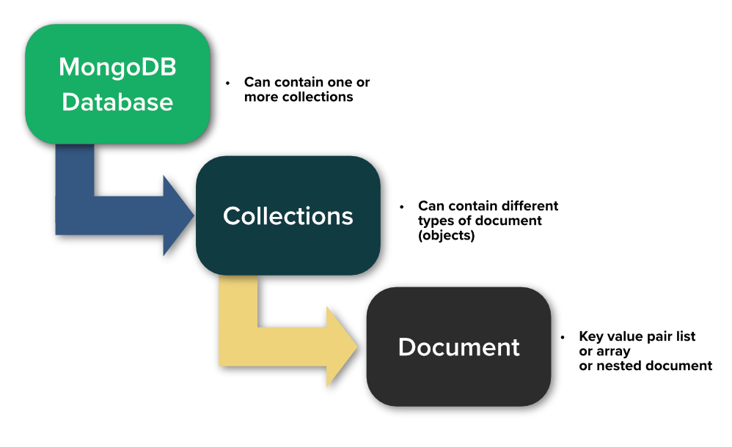
Accessing a Collection
Access a collection using the `db.collectionName` syntax.
Collections can be accessed within a database context.
It is essential to ensure the database connection is established first.
Notes:
Image source: https://studio3t.com/academy/lessons/mongodb-basics/

Slide 6

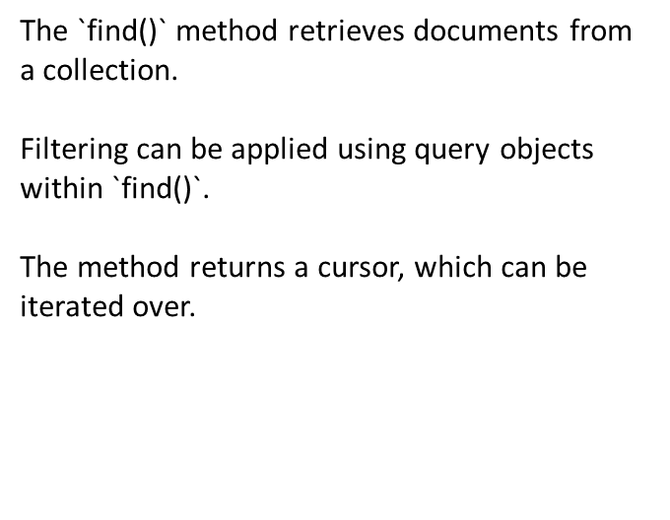
Inserting Documents
Use the `insertOne()` method to add a single document.
The `insertMany()` method allows for batch insertion of multiple documents.
Each inserted document receives a unique `_id` field by default.
Notes:
Image source: https://www.youtube.com/watch?v=4syeZCqPIRM

Slide 7
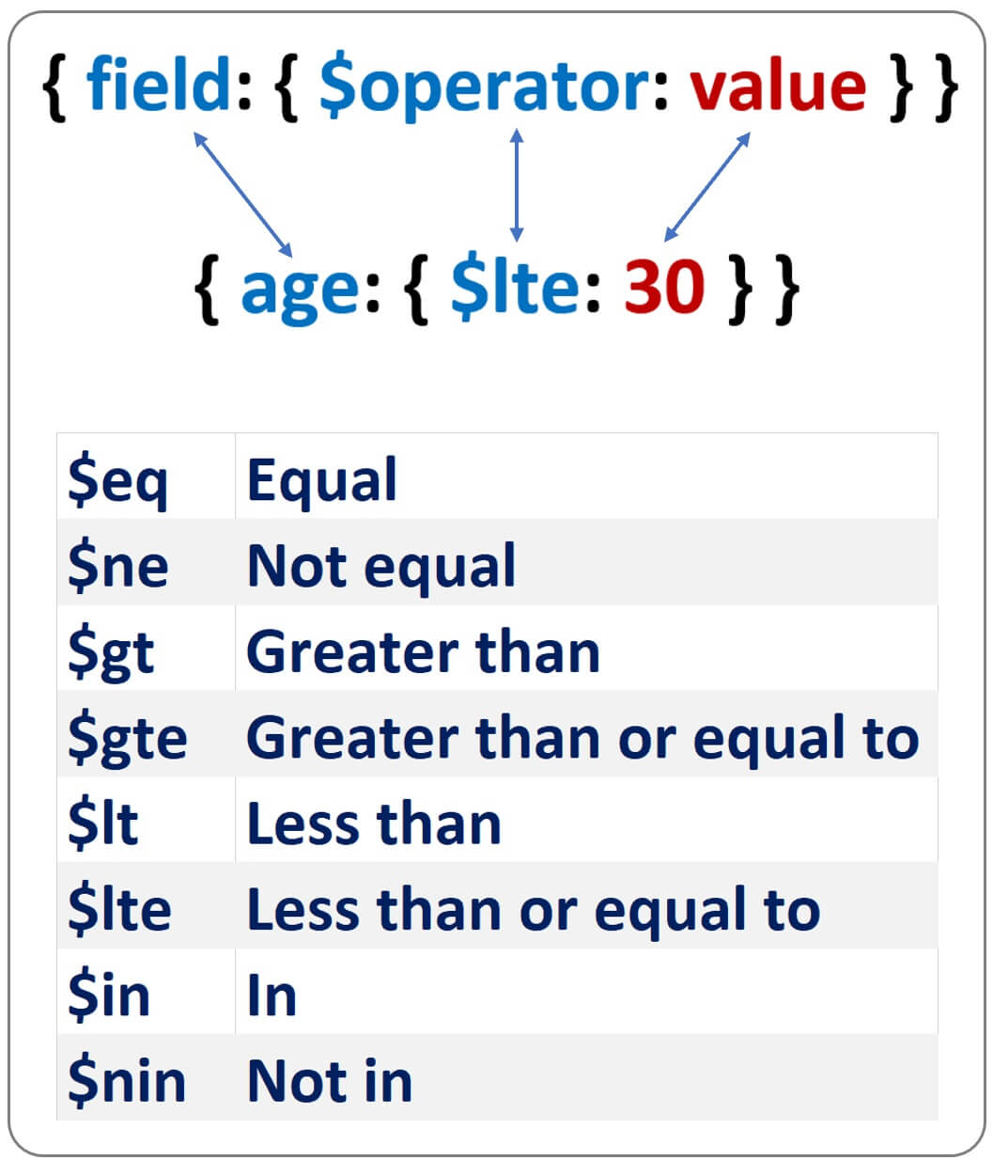
Query Operators
MongoDB supports various query operators for filtering.
Common operators include `$eq`, `$gt`, `$lt`, and `$in`.
These operators help in refining search results effectively.
Notes:
Image source: https://www.pragimtech.com/blog/mongodb-tutorial/getting-started-with-mongodb-database/

Slide 8
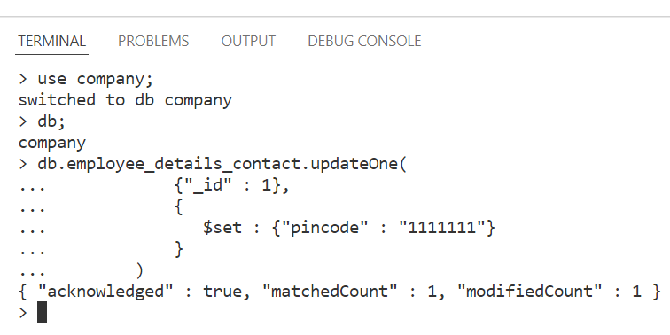
Updating Documents
Use the `updateOne()` method to modify a single document.
The `updateMany()` method can update multiple documents simultaneously.
MongoDB provides various update operators like `$set`, `$unset`, and `$inc`.
Notes:
Image source: https://www.geeksforgeeks.org/mongodb-queries-document/

Slide 9
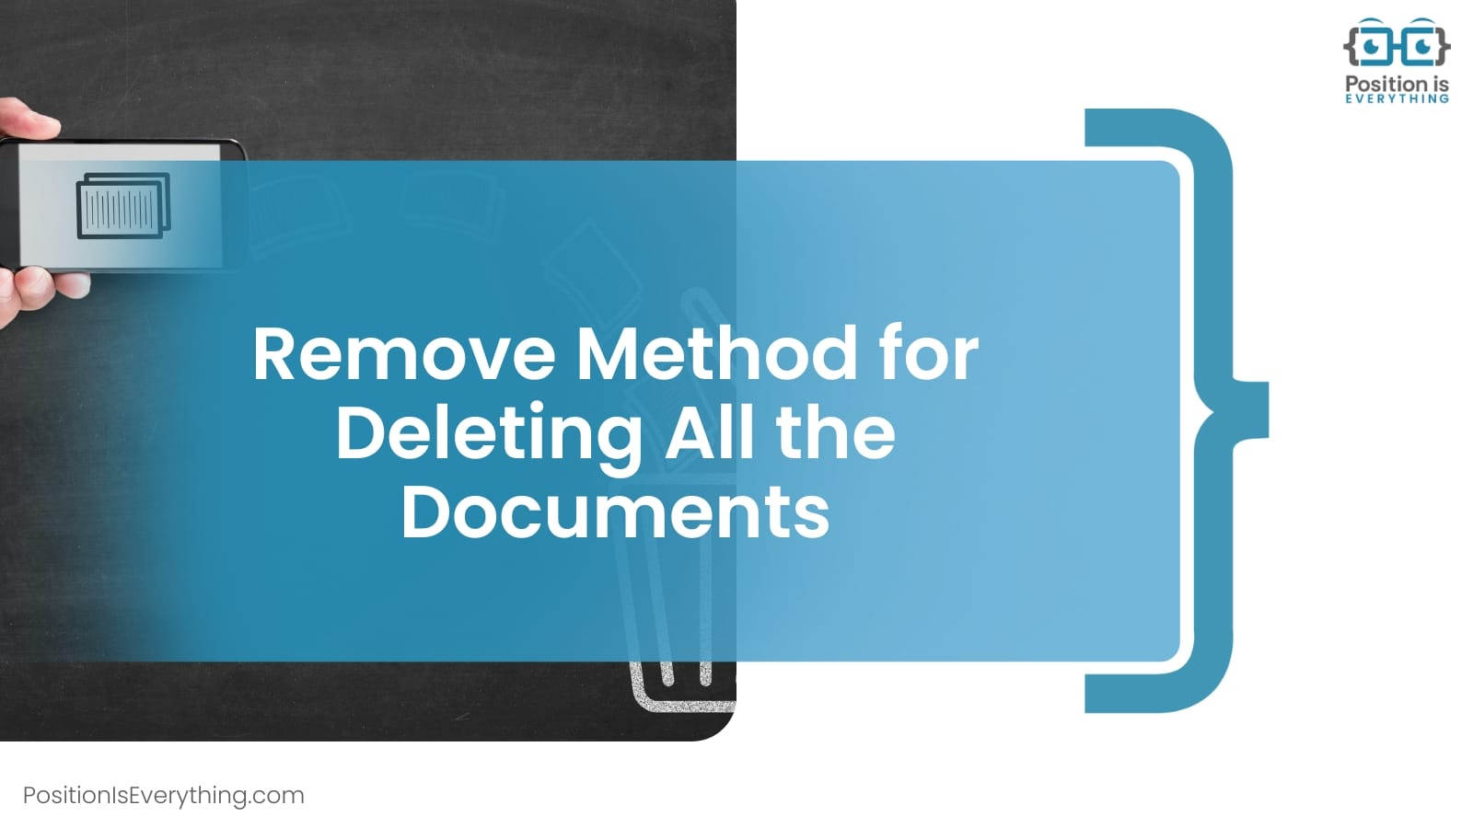
Deleting Documents
The `deleteOne()` method removes a single document from a collection.
Use `deleteMany()` to delete multiple documents that match a query.
Proper filtering is crucial to avoid unintentional data loss.
Notes:
Image source: https://www.positioniseverything.net/mongodb-delete-collection/

Slide 10
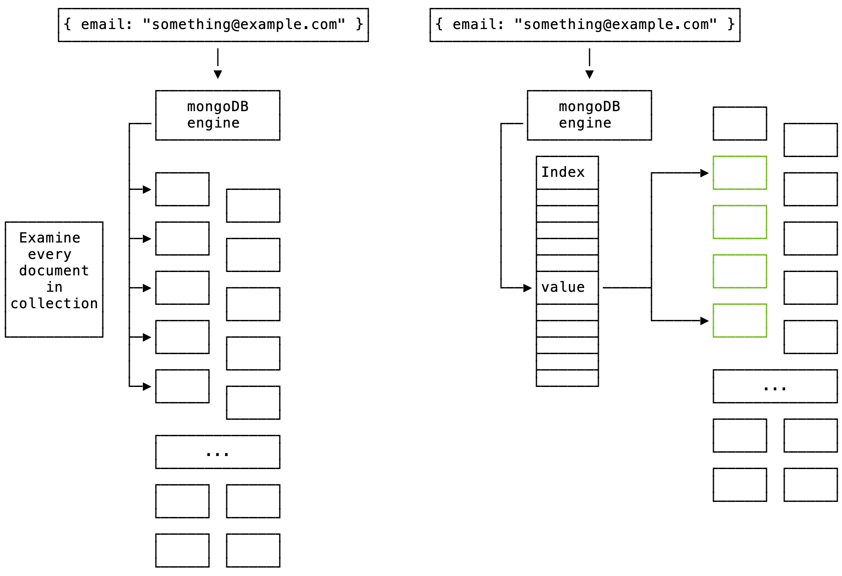
Indexing Collections
Indexes improve the performance of search queries in a collection.
MongoDB supports various index types, including single-field and compound indexes.
Create indexes using the `createIndex()` method on a given field.
Notes:
Image source: https://ifelse.io/2020/06/19/mongodb-performance-fundamentals-indexing-indexes

Slide 11
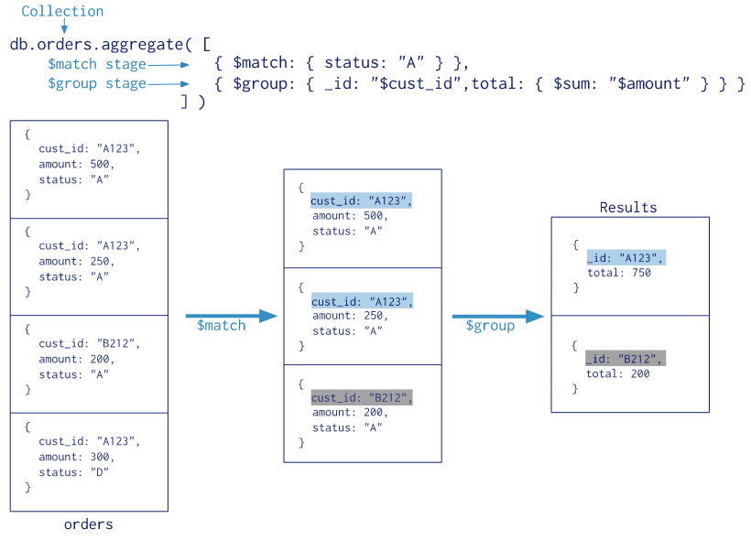
Aggregation Framework
The aggregation framework processes data and returns computed results.
It allows for operations like filtering, grouping, and sorting.
Use the `aggregate()` method to perform complex data manipulations.
Common stages include `$match`, `$group`, and `$sort`.
Notes:
Image source: https://velog.io/@tastestar/MongoDB-Aggregation-Framework

Slide 12
Conclusion and Resources
MongoDB offers powerful tools for accessing and manipulating collections.
Understanding its features can significantly enhance data management.
Explore additional resources and documentation for advanced usage.
This presentation provides a comprehensive overview of accessing and manipulating collections in MongoDB, covering various topics from basic operations.
Notes:
Image source: https://digitalvarys.com/introduction-to-mongodb/

Slide 13
Thank You!!!

